Slide 1
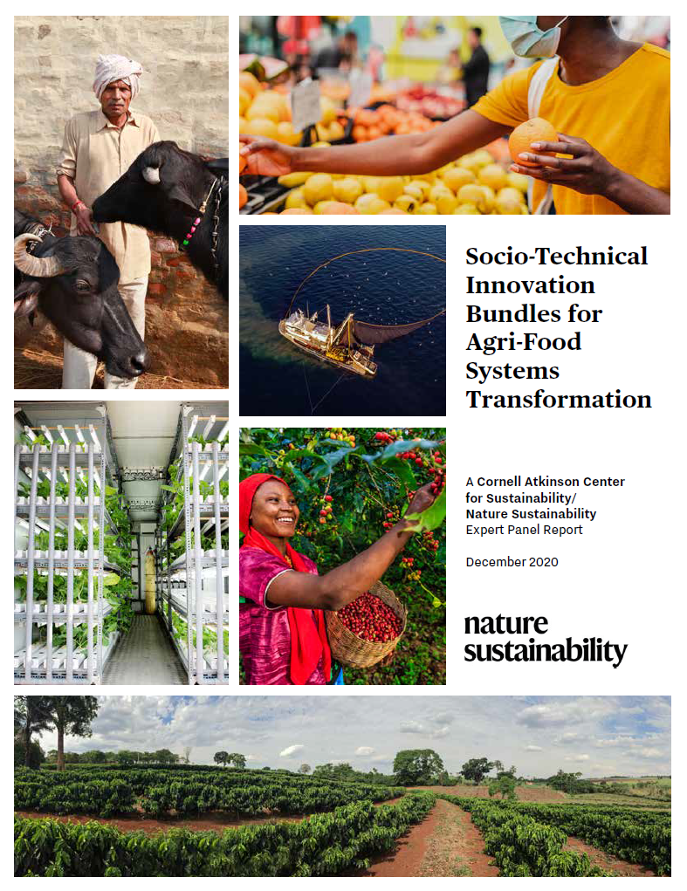
Why Bundling Innovations Is
Essential to Agri-Food
Systems Transformation
Christopher B. Barrett
Cornell University
Presentation to USDA Foreign Agricultural Service expert-to-expert dialogue in support of UN Food Systems Summit Action Track 5
Hosted by University of California-Davis
June 28, 2021

Slide 2
R&D valuable but not always 1st limiting
A profuse pipeline exists of promising (natural and social) science advances at various stages of deployment readiness. Span value chains and geographies.

Slide 3
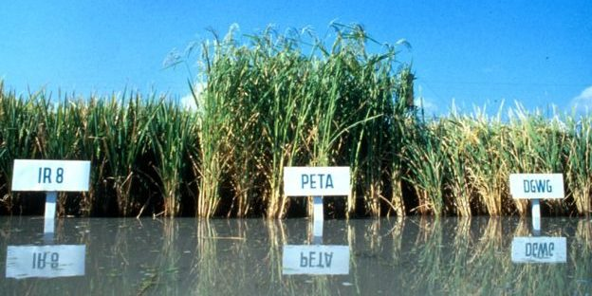
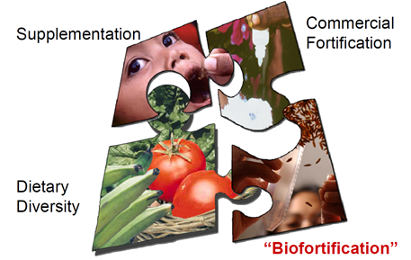
Bundling of social/technical innovations key
Why bundle? No magic bullets exist.
(1) Synergies to adapt/scale.
(2) Political economy of spillovers
and creative destruction.
3) Heterogeneous needs require
complementary interventions
Photo credit: IRRI
Photo: Gerry Machen/Creative Commons
Graphic credit: Ross Welch/Mike Gore

Slide 4
Bundling invites co-creation, shared and verified responsibility among parties.
Thank you for your time and interest!
Notes:
4

